Slide 1
LIFE
IN THE
Womb
Education. Life. Mothers.
www.elmpregnancycenter.com

Slide 2
PSALMS 139:13-16
For you created my inmost being;
you knit me together in my mother’s womb.
I praise you because I am fearfully and wonderfully made;
your works are wonderful, I know that full well.
My frame was not hidden from you
when I was made in the secret place,
when I was woven together in the depths of the earth.
Your eyes saw my unformed body;
all the days ordained for me were written in your book
before one of them came to be.

Slide 3
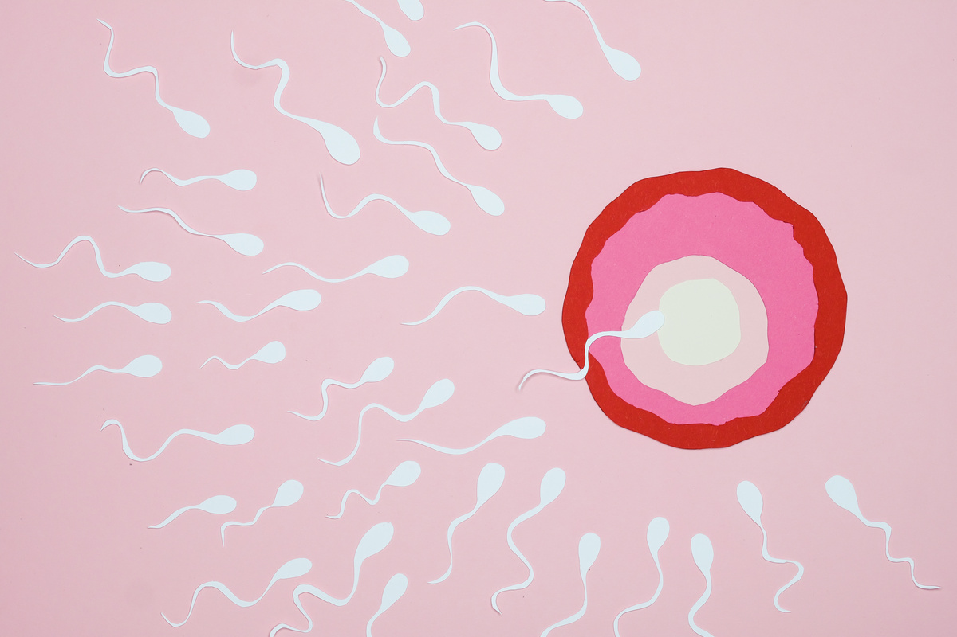
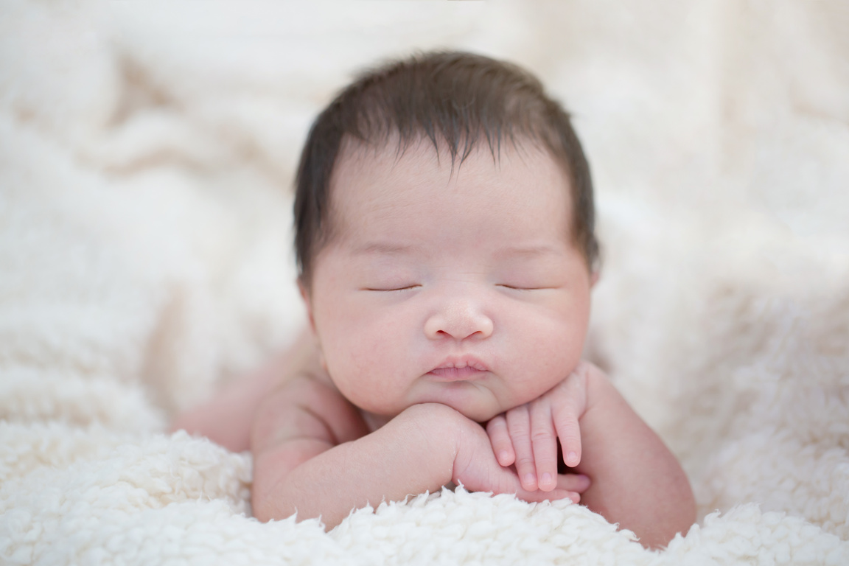
WHEN DOES LIFE BEGIN?
Life begins at conception when a sperm and egg come together

Slide 4

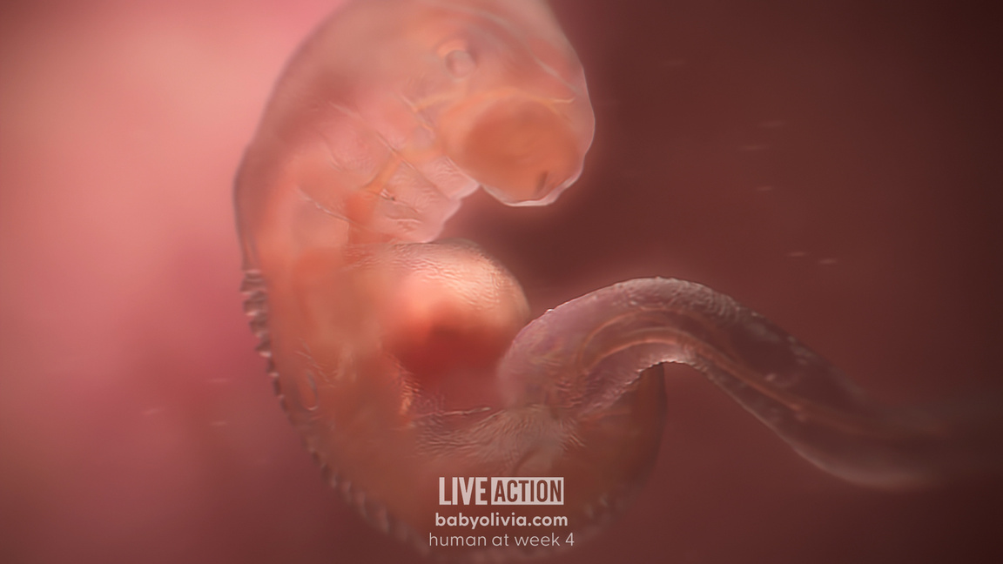
MONTH 1
Before a woman knows she’s pregnant…
  Heart, brain, & spinal cord form
  Heart beats and pumps blood at 21 days
  Arm and leg buds appear

Slide 5
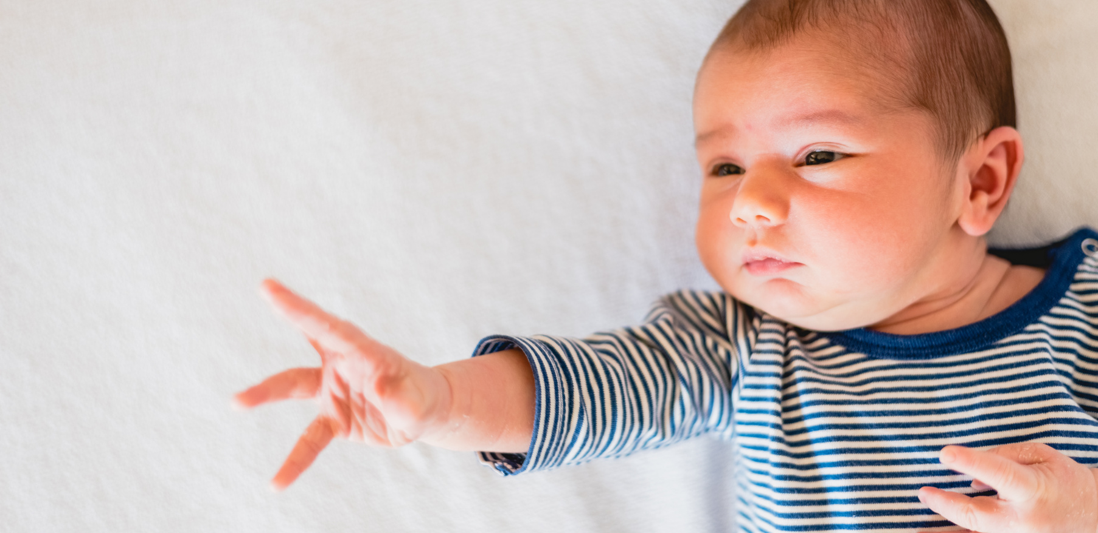
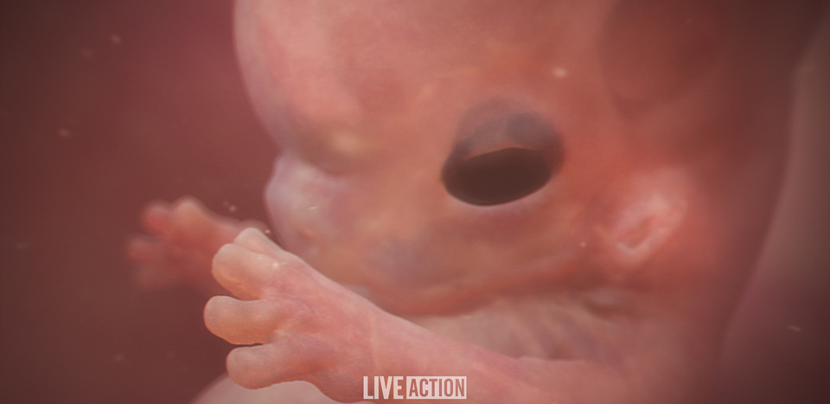
MONTH 2
  Baby has 90% of the structures found in adults
  Baby begins to move
  Facial features including eyelids appear
  The Mother cannot yet feel the baby move

Slide 6
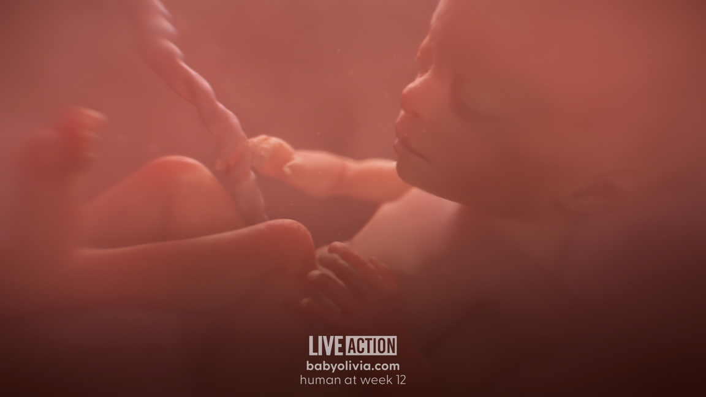
MONTH 3
  Kidneys, stomach, and liver are working
  Baby receives all nutrition from umbilical cord

Slide 7
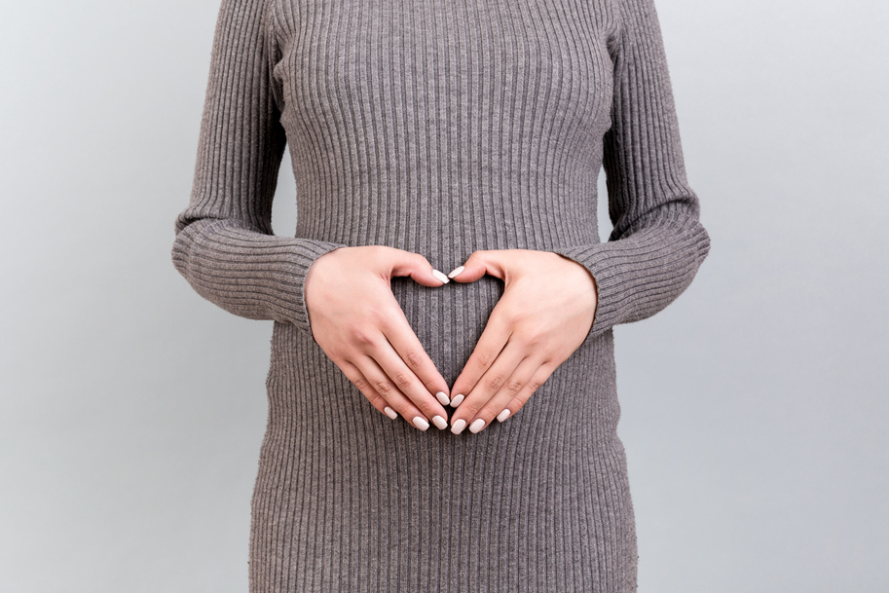


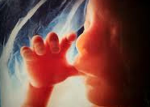
MONTH 4
  Opens mouth, moves lips, sucks thumb, yawns and swallows
  Eyes can make sideways movements
  Finger and toenails appear
  Mother can feel her baby move

Slide 8
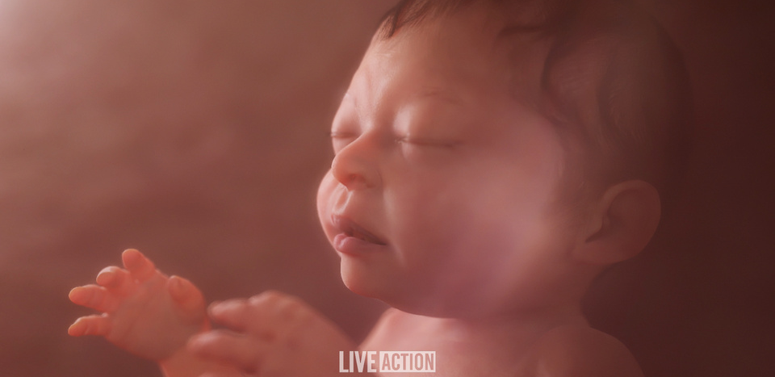
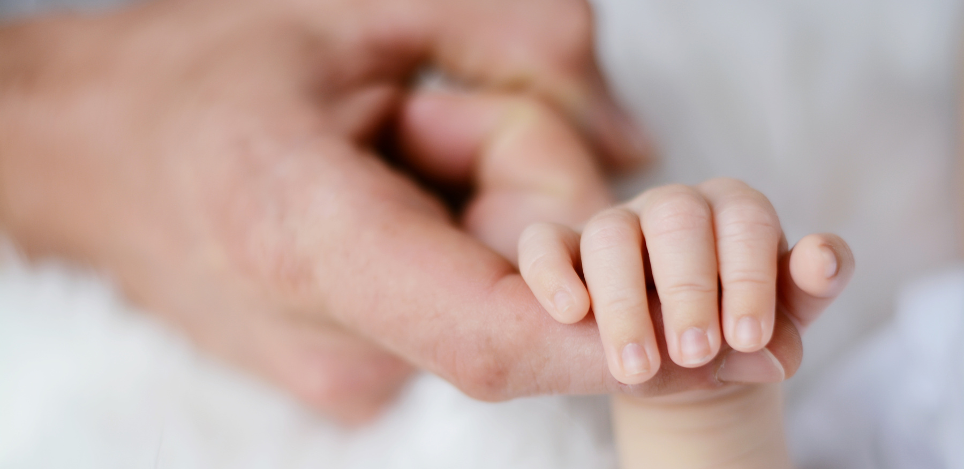
MONTH 5
  Baby can feel pain
  Fingerprints can be seen
  Eyes are formed knowing light from dark.

Slide 9
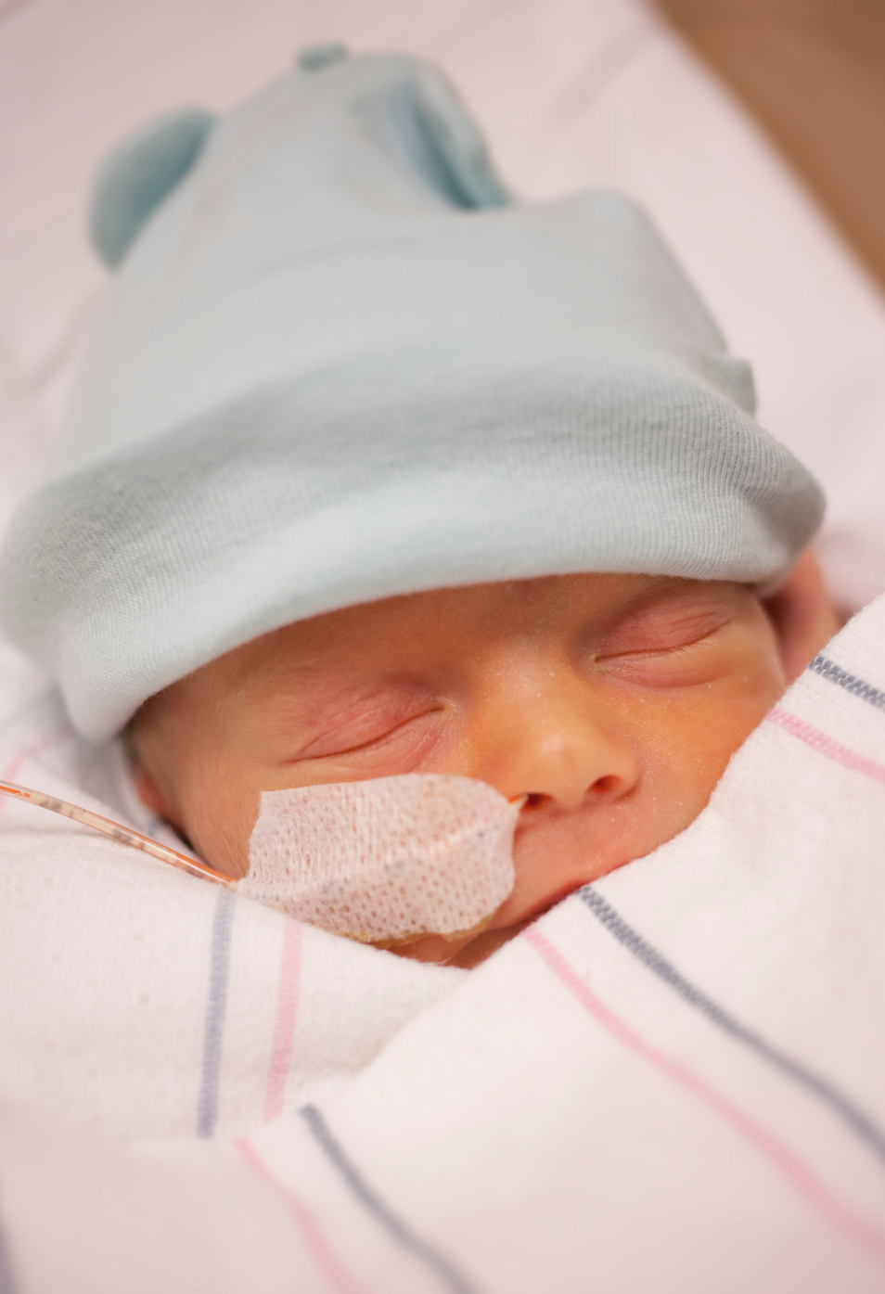
MONTH 6
  Baby has a chance of survival if born
  Hears and recognizes Mother and Father’s voices
  Smiles & frowns
  Dreams

Slide 10
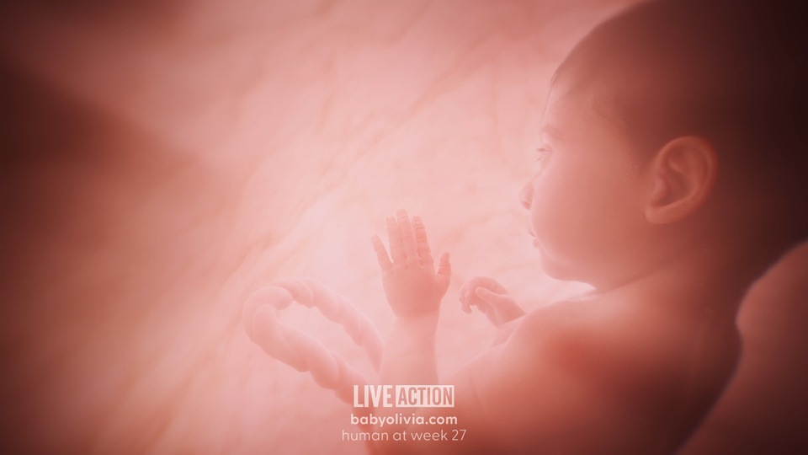

MONTH 7
  Baby’s vocal cords are now active
  Eyebrows are formed and eyes can make tears
  Lungs are getting stronger

Slide 11
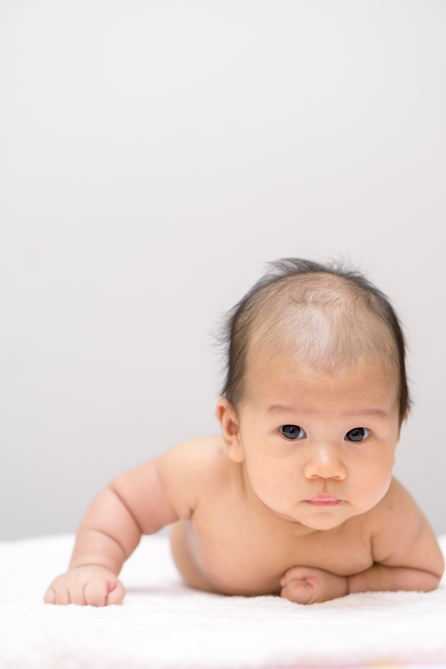
MONTH 8
  Baby turns head down to prepare for birth
  Skin becomes smooth
  Hair begins to thicken
  Bones are all developed
  Hands can grasp firmly

Slide 12
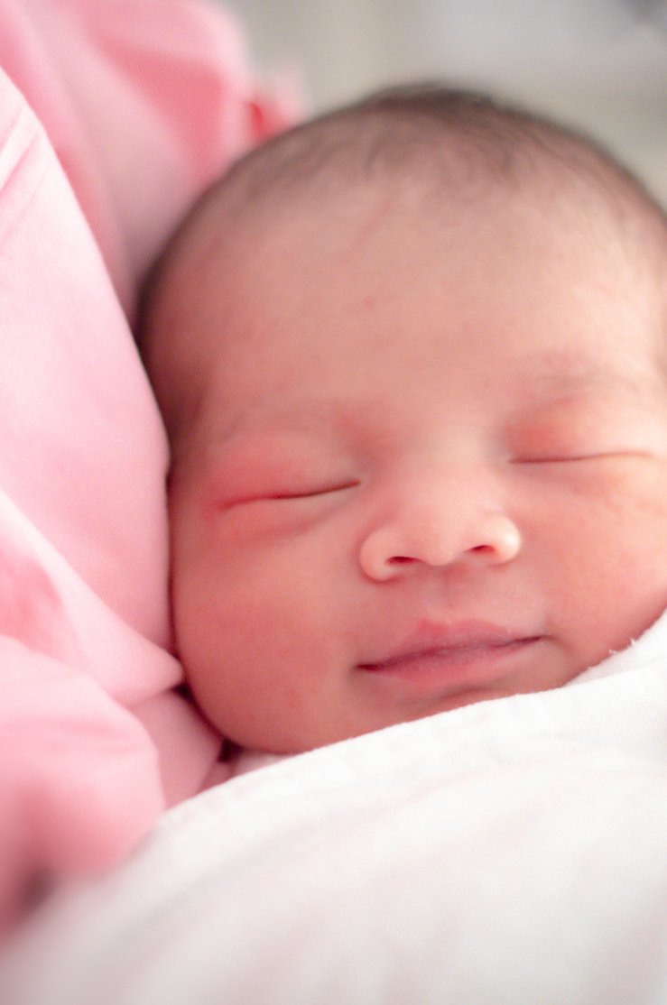
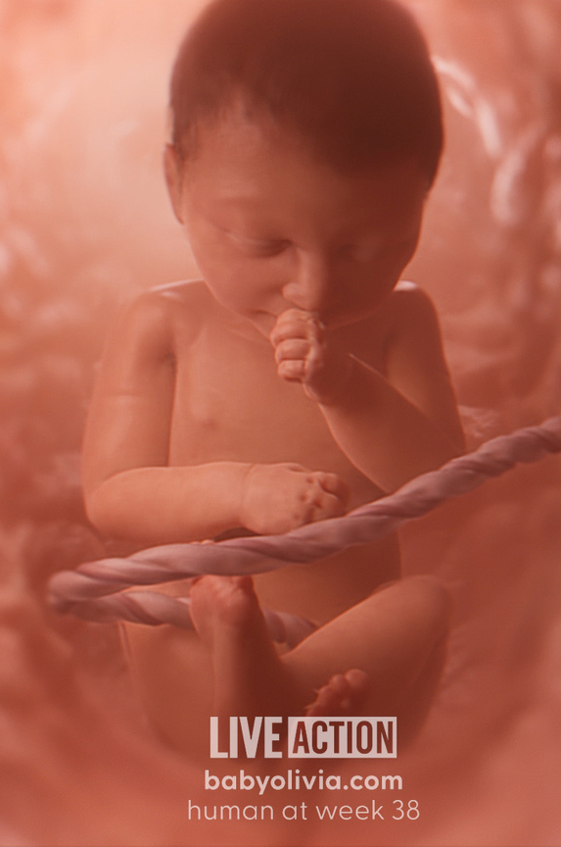
MONTH 9
  Baby takes first breath
  Baby is an incredible creation of God!
  Every life has value from conception until death
  Life is important to God, because God created you

Slide 13
PSALMS 139:13-16
For you created my inmost being;
you knit me together in my mother’s womb.
I praise you because I am fearfully and wonderfully made;
your works are wonderful, I know that full well.
My frame was not hidden from you
when I was made in the secret place,
when I was woven together in the depths of the earth.
Your eyes saw my unformed body;
all the days ordained for me were written in your book
before one of them came to be.

